Slide 1
arsenelupin1620

Slide 2
Your rating: 1595
Opponent rating: 1291

Slide 3
Your rating: 1595
Opponent rating: 1291
LOSS :(

Slide 4
Your rating: 1548
Opponent rating: 1328

Slide 5
Your rating: 1548
Opponent rating: 1328
LOSS :’(

Slide 6
Your rating: 1536
Opponent rating: 1101

Slide 7
Your rating: 1536
Opponent rating: 1101
LOSS >:(

Slide 8
arsenelupin1620

Slide 9
arsenelupin1620
Churn :(

Slide 10
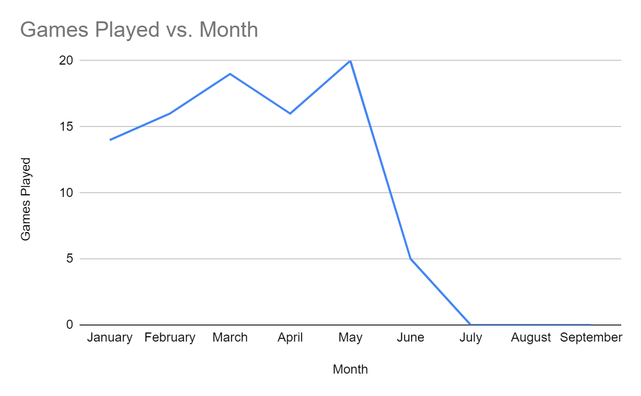
arsenelupin1620

Slide 11
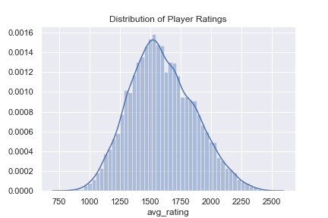
Are they bad?

Slide 12
Are they bad?
Not really

Slide 13
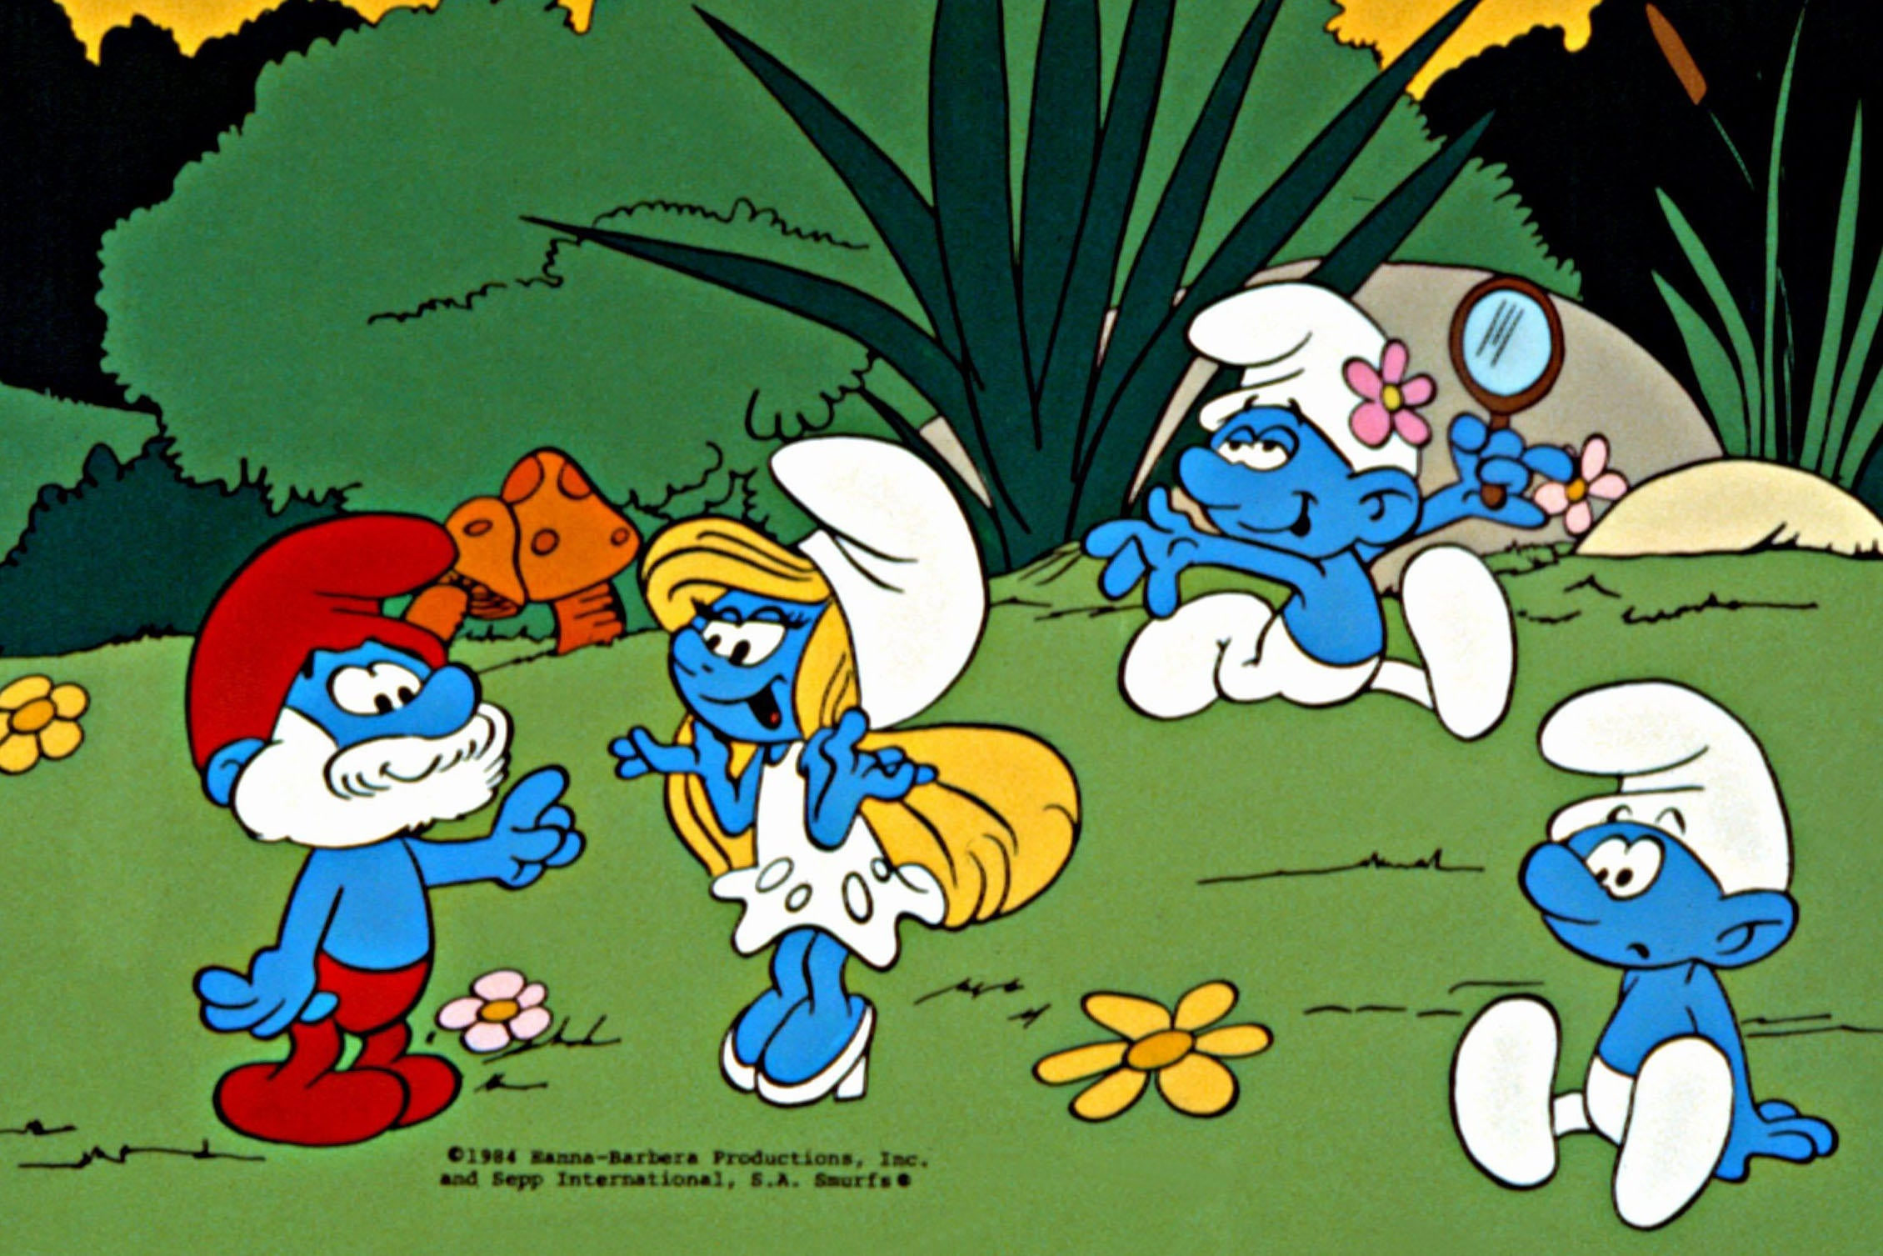
Smurfing

Slide 14
Detecting Smurfs

Slide 15
Good Player Top Tendencies

Slide 16
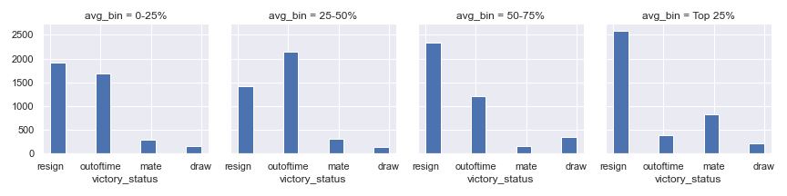
Good players resign or mate

Slide 17
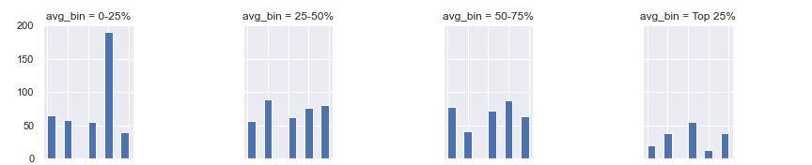
Good players use
more varied openings
Top 5 Openings Frequency by Player Rating

Slide 18
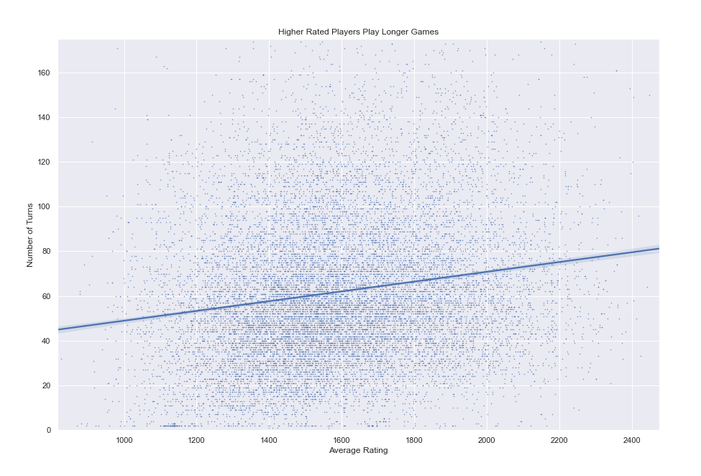
Good players play longer games

Slide 19
Action Items

Slide 20
Action Items
Three Match CPU Assessment

Slide 21
Action Items
Three Match CPU Assessment
Monitor Players with Smurfing Tendencies

Slide 22
Action Items
Three Match CPU Assessment
Monitor Players with Smurfing Tendencies
Adjust ELO accordingly

Slide 23
Action Items
Three Match CPU Assessment
Monitor Players with Smurfing Tendencies
Adjust ELO accordingly
Suspend or ban repeat offenders

Slide 24
Action Items
Three Match CPU Assessment
Monitor Players with Smurfing Tendencies
Adjust ELO accordingly
Suspend or ban repeat offenders
Fun Play Environment

Slide 25
Action Items
Three Match CPU Assessment
Monitor Players with Smurfing Tendencies
Adjust ELO accordingly
Suspend or ban repeat offenders
Fun Play Environment
Win back arsenelupin1620 :)

Slide 26
Appendix/Project Details
This project was completed for the Springboard Data Science Career Track.
The intended hypothetical audience for this presentation is LIChess’s executive board.
The main question asked during analysis was “What characterizes higher ranked chess play?”
The source dataset can be found here: https://www.kaggle.com/datasnaek/chess
Only ranked games were used for the analysis.
The Jupyter notebook for generating viz is here: https://github.com/abewoycke/Springboard/blob/master/Data%20Storytelling%20Mini%20Project/Data%20Storytelling%20Mini%20Project%20Second%20Dataset.ipynb

